Slide 1

OPEN SAR TOOLKIt
introduction

Slide 2
What is the open sar toolkit
based on free and open source software components
provide easy access to freely available SAR datasets
allow non-SAR experts to pre-process SAR data
automatized routines to produce analysis ready data
provide additional information on SAR remote sensing

Slide 3










Design & Concept
Based on top of:
SNAP (SAR related operations)
GDAL, python, R (GIS functionalities)
Orfeo (mosaicking)
Accessibility
GUI (R-Shiny)
CLI (bash)
Runs on:
Linux (natively, developed on Ubuntu 16.04)
Mac OS, Windows 10 (via docker, not widely tested yet)

Slide 4
Easy Access
Sentinel-1
search and download for all kind of S1 products
ALOS Kyoto & Carbon mosaics
free for non-commercial use
yearly global mosaics
JERS-1: 1996
ALOS PALSAR-1: 2007, 2008, 2009, 2010
ALOS PALSAR-2: 2015, 2016, ongoing

Slide 5

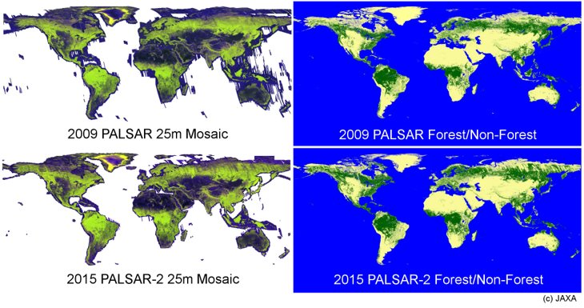
ALOS Kyoto & Carbon mosaics
Download by:
AOI Shapefile
Country boundaries
Processing:
Mosaicking of tiles
HH/HV ratio and RFDI creation
Shapefile with acquisition dates
Layover/Shadow mask
Speckle filter (optional)

Slide 6
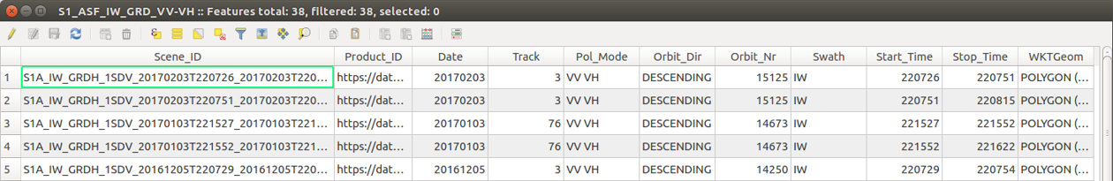
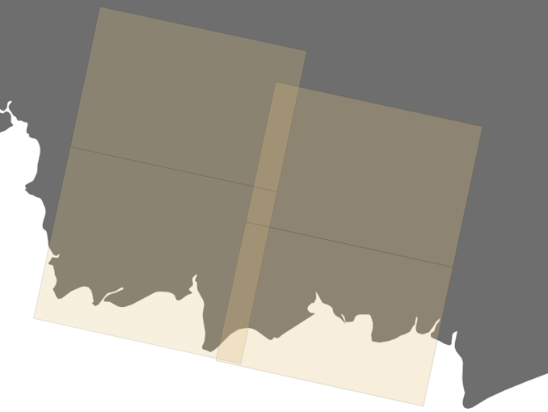
Sentinel-1
Search by:
AOI Shapefile
Country boundaries
Refinement by:
OST inventory shapefile
contains relevant information on acquisitions
Download by:
OST inventory shapefile
Predefined folder structure for subsequent bulk processing

Slide 7

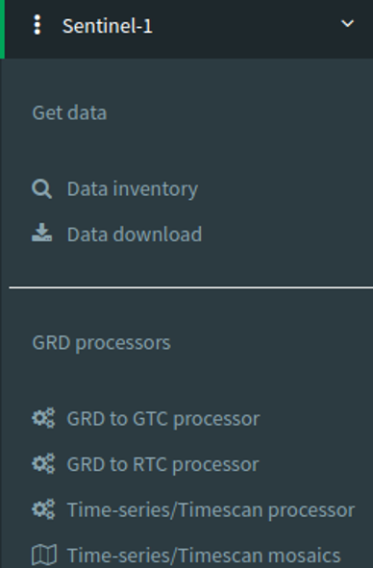
Sentinel-1
Supported Products for processing:
Interferometric WS mode
VV & VV/VH polarization
Level-1 GRD
Automatized Processors:
1a: GRD to GTC
1b: GRD to RTC
2: Time-series preparation
3: Timescan composites
4: Mosaicking

Slide 8
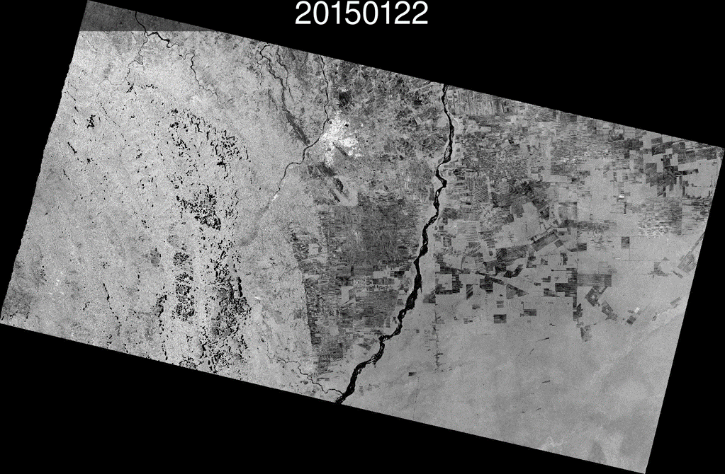
Sentinel-1
Time-series processor
Example: Bolivia (VV-pol)
co-registered
same extent and resolution
temporal dynamics
disturbances by heavy rainfall

Slide 9
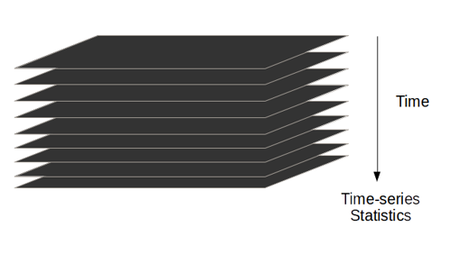
Sentinel-1
Timescan processor
Calculate basic descriptive statistics in time
Mean, Min, Max, SD, CoV
Advantages:
Reduction in storage needs
Reduction of noise / enhance information
Capture temporal dynamics

Slide 10
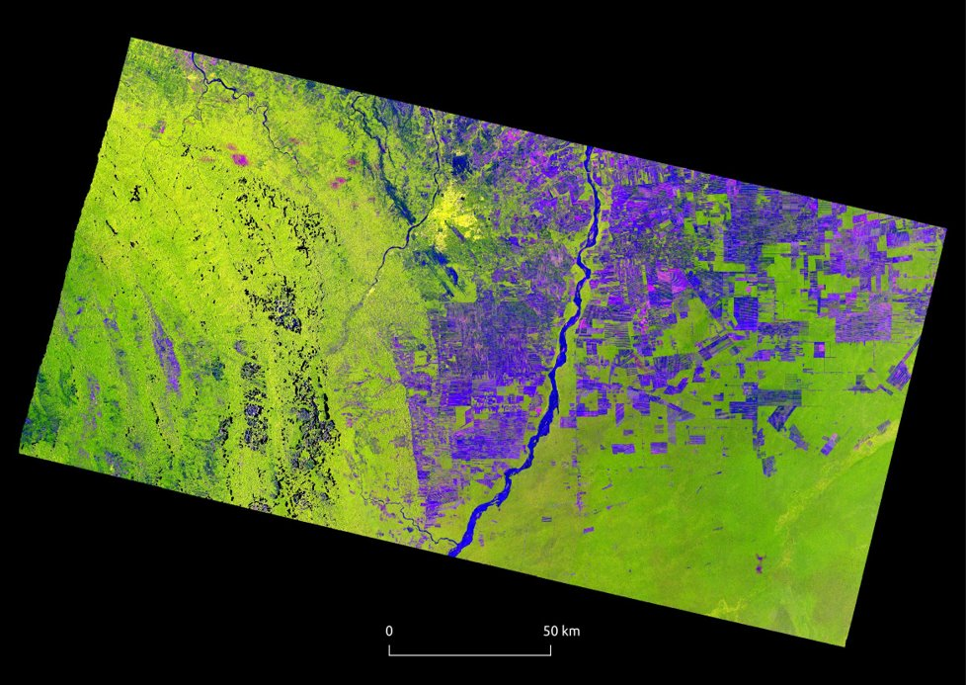
Sentinel-1
Example single-pol (VV)
Bolivia Timescan composite
22 acquisitions per swath
Timescan composite
Red: VV-max
Green: VV-min
Blue: VV-SD
Temporal dynamics related to Land cover:
Urban, Forest --> stable
Bare, Agric. --> dynamic

Slide 11
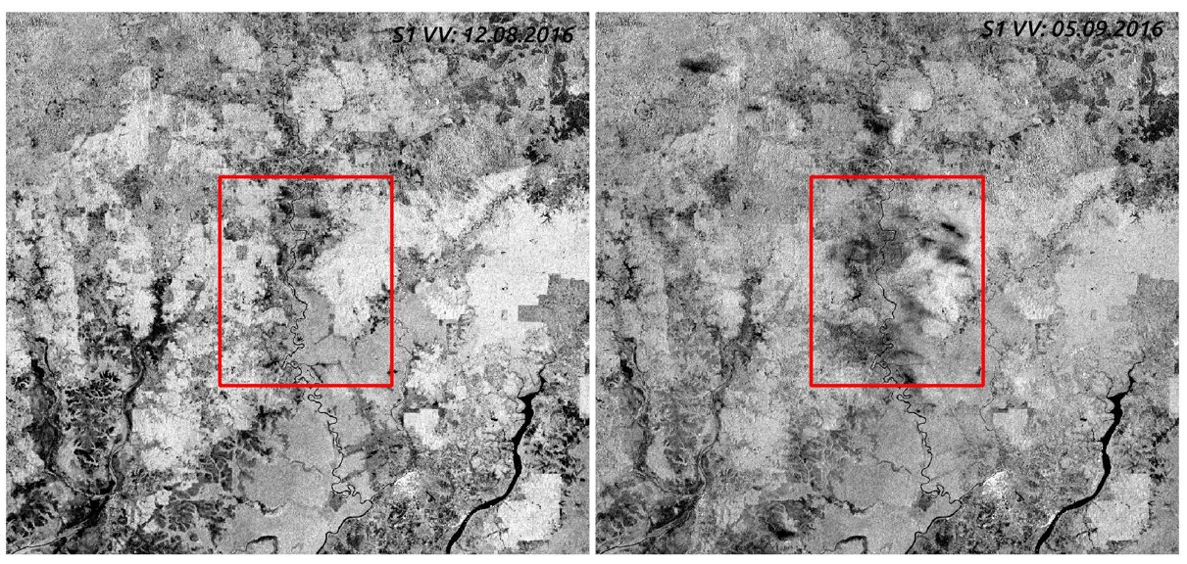
Sentinel-1
Issues with heavy rainfall events over tropics

Slide 12
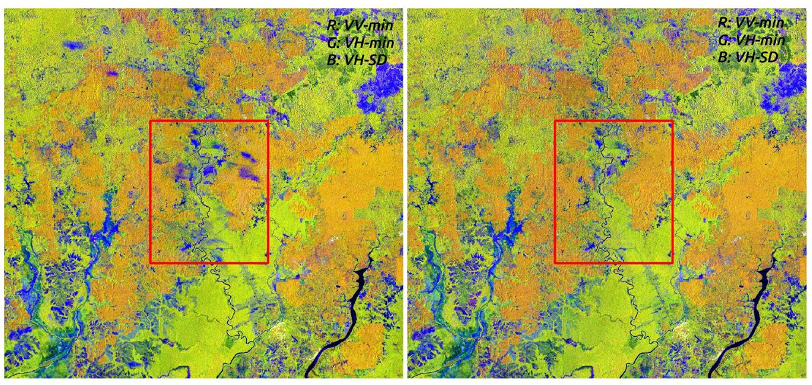
Sentinel-1
Temporal outlier removal in our time-series

Slide 13
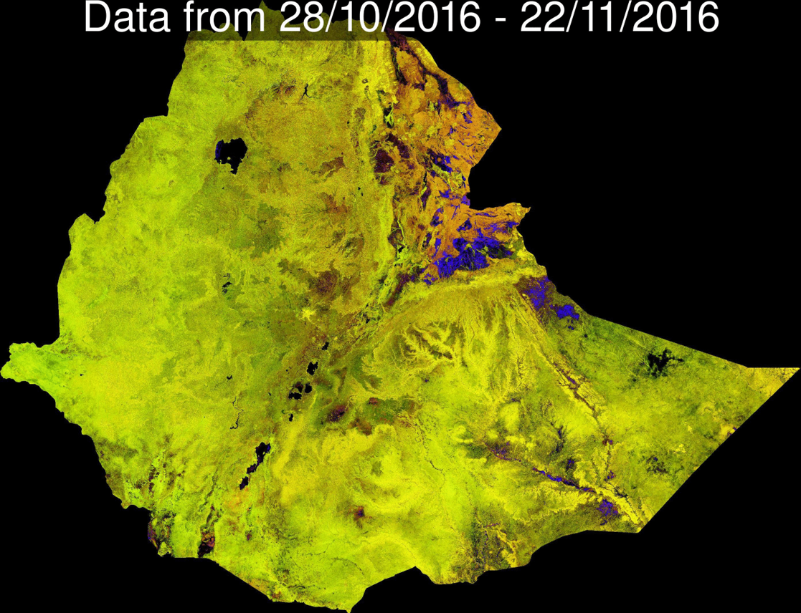
Sentinel-1 mosaicking
Time-series:
Mosaicking of 8 swaths
Standard RGB composites of Ethiopia
Red: VV
Green: VH
Blue: VV/VH
with new 12 day repeat global: large-scale, bi-weekly mosaics possible

Slide 14
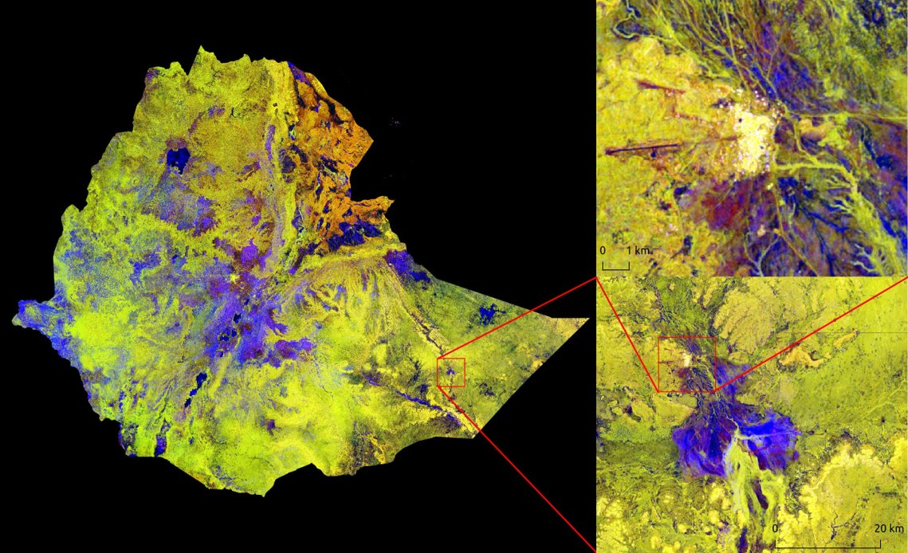
Sentinel-1 mosaicking
Timescan
Dual-pol composite (VV & VH)
Red: VV-min
Green: VH-min
Blue: VH-SD
7 acq. per 8 swaths
Includes info from about 310 scenes
30 m resolution (63677 x 46161 pixels per band)

Slide 15
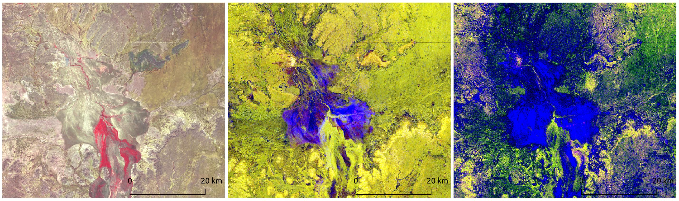
Multi-Sensor integration
Cloud-free spectral
Temporal/Structural
Structural
Landsat 8 best pixel composite / False Color
Sentinel-1 Timescan
ALOS K&C (JAXA courtesy)

Slide 16
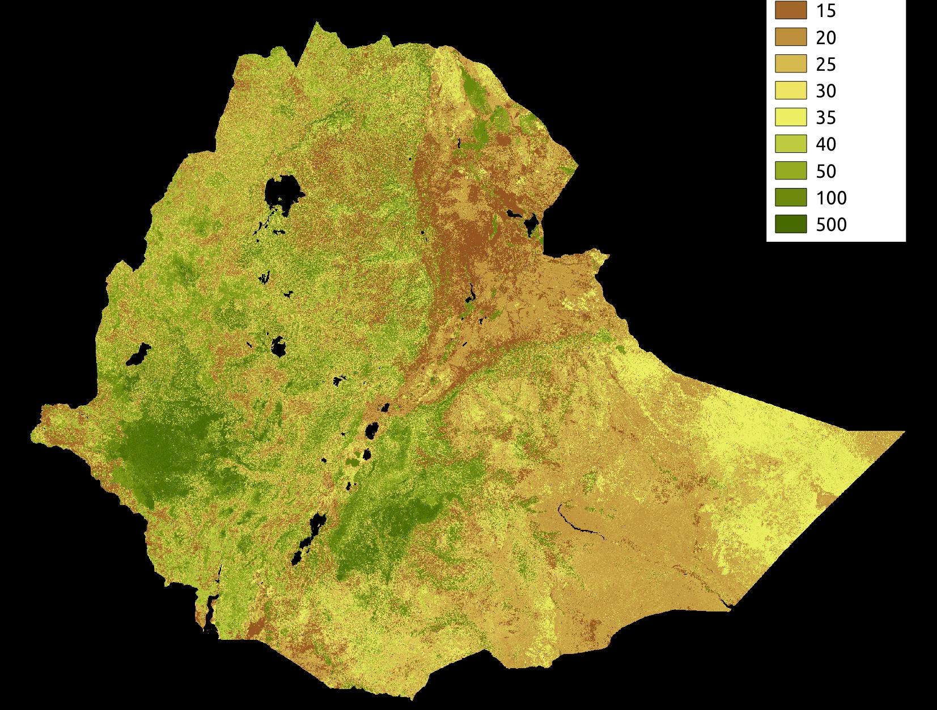
Example
Biomass map of ethiopia 2016 based on combination of NFI data and multi-sensor stack

